Slide 1

Two days workshop on Deep Learning
Under Auspices of Lead India AI
Dr Amita Kapoor
Associate Professor,
Shaheed Rajguru College of Applied Sciences for Women

Slide 2





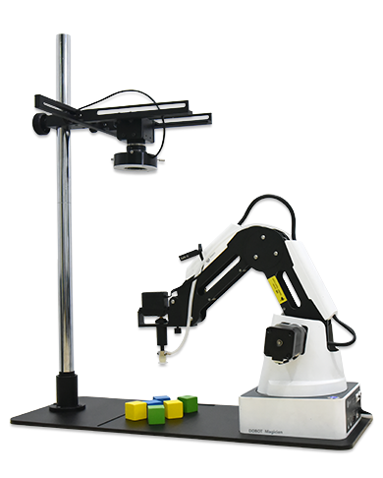
About Me
Beta Tester and Reviewer Udacity: A US based for-profit educational organization.
Mentor: Aerial Robotics, University of Penn, Coursera
Mentor IEEE : An internationally acclaimed non-profit organization.
Advisor DeepSight AI Labs: An Indo-US startup working in the area of AI based Surveillance.
Advisor FeynLabs.AI: A UK based social effort to teach AI and Robotics.
Author: TensorFlow 1.x Deep Learning Cookbook, Packt Publishers
Associate Professor, SRCASW, University of Delhi
Email: dr.amita.kapoor@ieee.org
Website: http://dramitakapoor.com

Slide 3






About Lead India AI
Making Deep Learning and AI skills mainstream in India to fulfil trilateral needs of entrepreneurship, Industry academia partnership and application-inspired Engineering Research.
Project Funded by Royal Academy of Engineering, UK under Newton Bhabha Fund.
Investigator : Dr. Deepak Garg, Dr. Vinit Jakhetiya and Dr. Sridhar Swaminathan (Project Manager)
Industry Partners: NVIDIA and AWS Educate, Videoken and Edvantics are industry partners.
Will have approximately 10 collaborator institutions, 100 Lead zonal partners and 1000 basic partner institutions, 10000 teachers and 1000000 Students
www.leadingindia.ai

Slide 4
Objectives of the Workshop
Introduce
Introduce you to the fantastic world of Artificial Intelligence.
Show
Show case some achievements of AI.
Foundation
Familiarize you with two foundational models of deep learning: MLP and CNN.
Motivate
Motivate some of you to delve deep into AI
Future Steps
Educate about steps you can take further

Slide 5
Designing new Compounds
Gene Sequencing
Disease Detection
Writing Books
Giving Legal advice
Financial Market
Grading answer Sheets
Machine Translation
Robotics
Face Recognition
Self Driving Cars
Drones
Creating Art
Choose Any field
and you will find application of Artificial Intelligence, Machine learning there
Music Generation
Notes:
Netflix, Amazon Recommendation
Facebook Feed
Word correction
Word Suggestion
Grammar Check

Slide 6
Artificial Intelligence
Emulate the intelligent Behaviour. Make machines do tasks, human are good at.
Machine Learning
Uses Statistical techniques that enable machines to improve performance with experience.
Deep Learning
Multiple (Deep) layers of Neural Networks, that can be trained to perform task like speech and image recognition by learning through vast amounts of data.

Slide 7

The first computer program to defeat a professional human Go player, the first program to defeat a Go world champion, and arguably the strongest Go player in history.
The game of Go originated in China 3,000 years ago.
The rules of the game are simple: players take turns to place black or white stones on a board, trying to capture the opponent's stones or surround empty space to make points of territory.
As simple as the rules are, Go is a game of profound complexity.
There are an astonishing 10 to the power of 170 possible board configurations - more than the number of atoms in the known universe
https://deepmind.com/research/alphago/
Notes:
March 2016
Deep Neural Network
Advance Tree searches
Reinforcement Learning

Slide 8
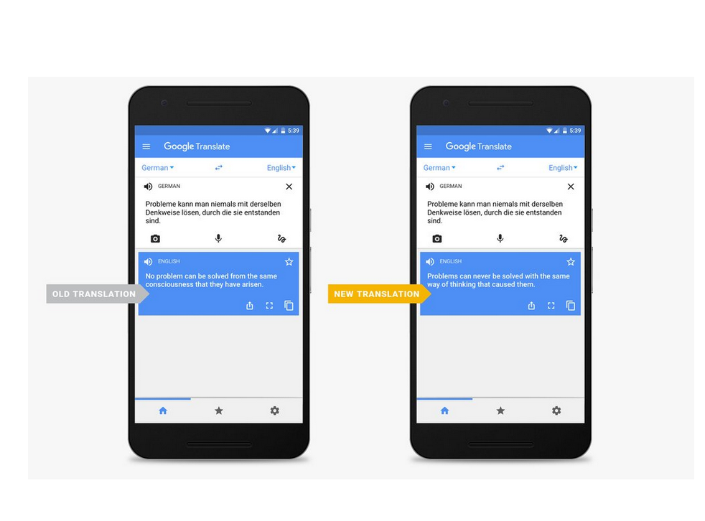
Notes:
2014

Slide 9
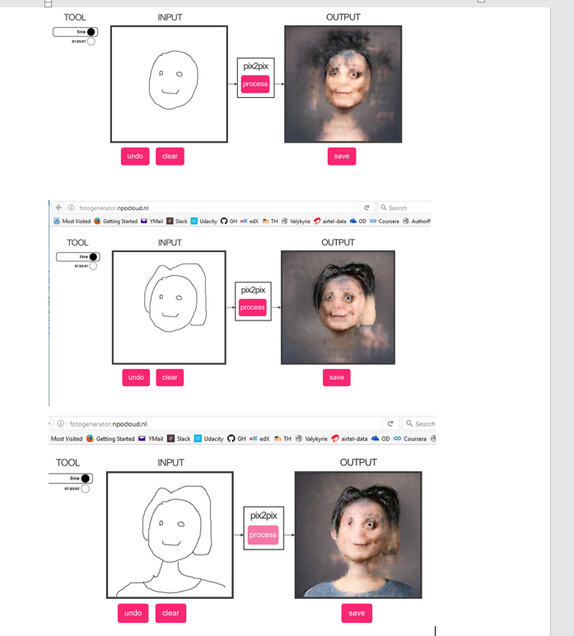
Notes:
Google Translate

Slide 10
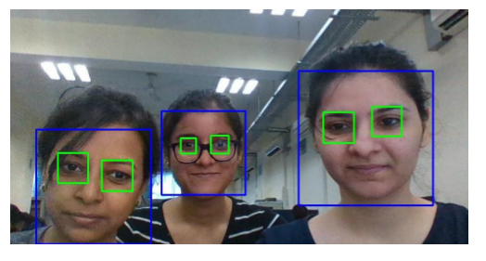

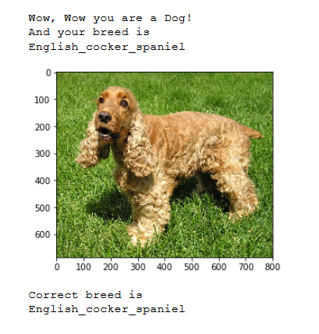
Notes:
Google Translate

Slide 12
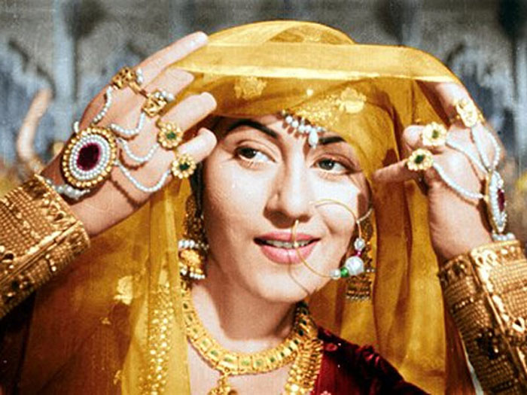
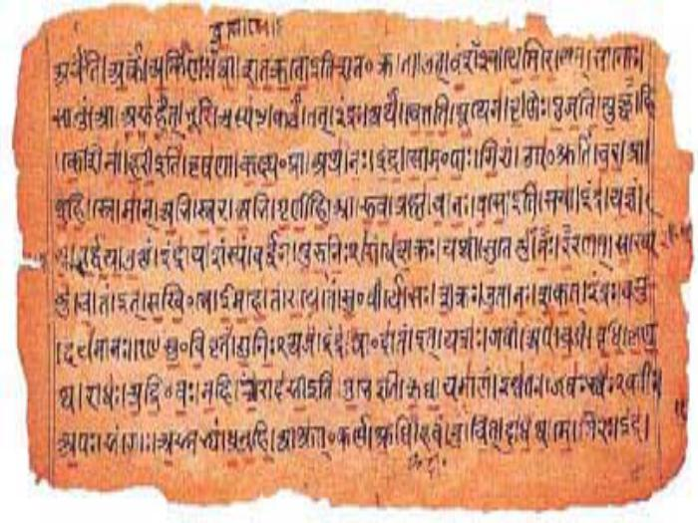
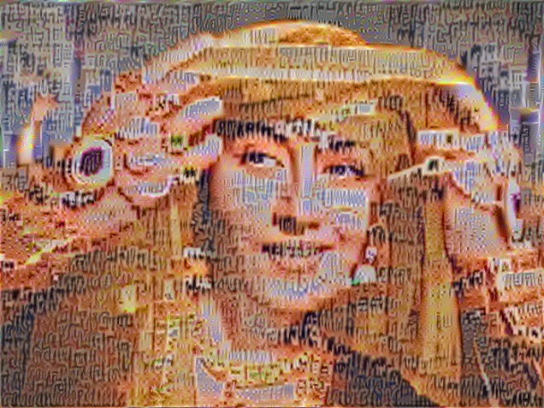

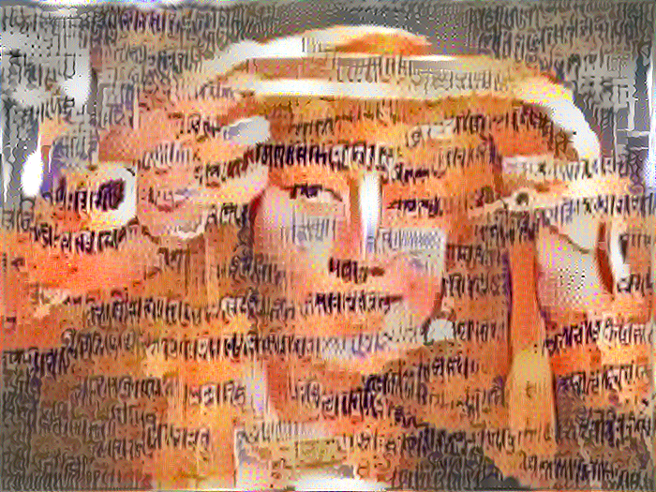

Slide 13
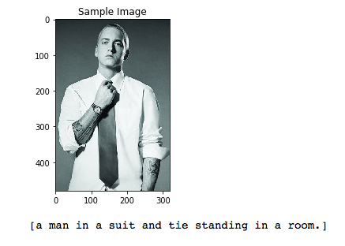
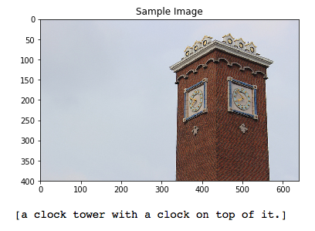

Slide 14
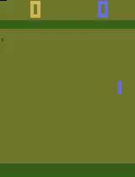
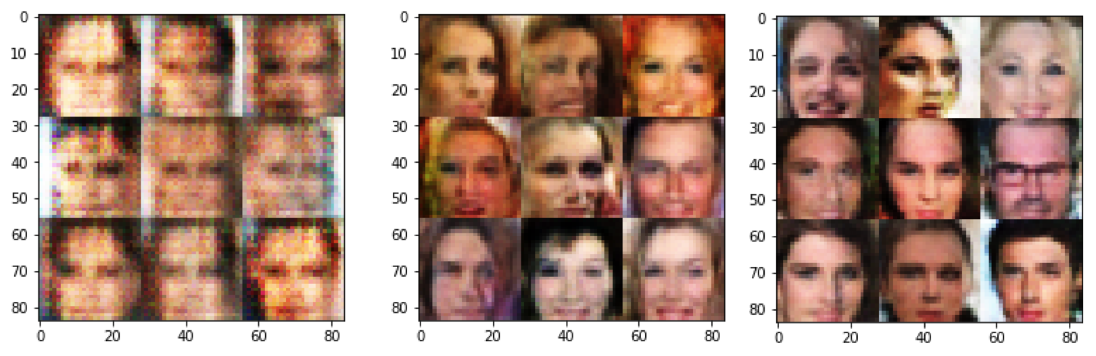
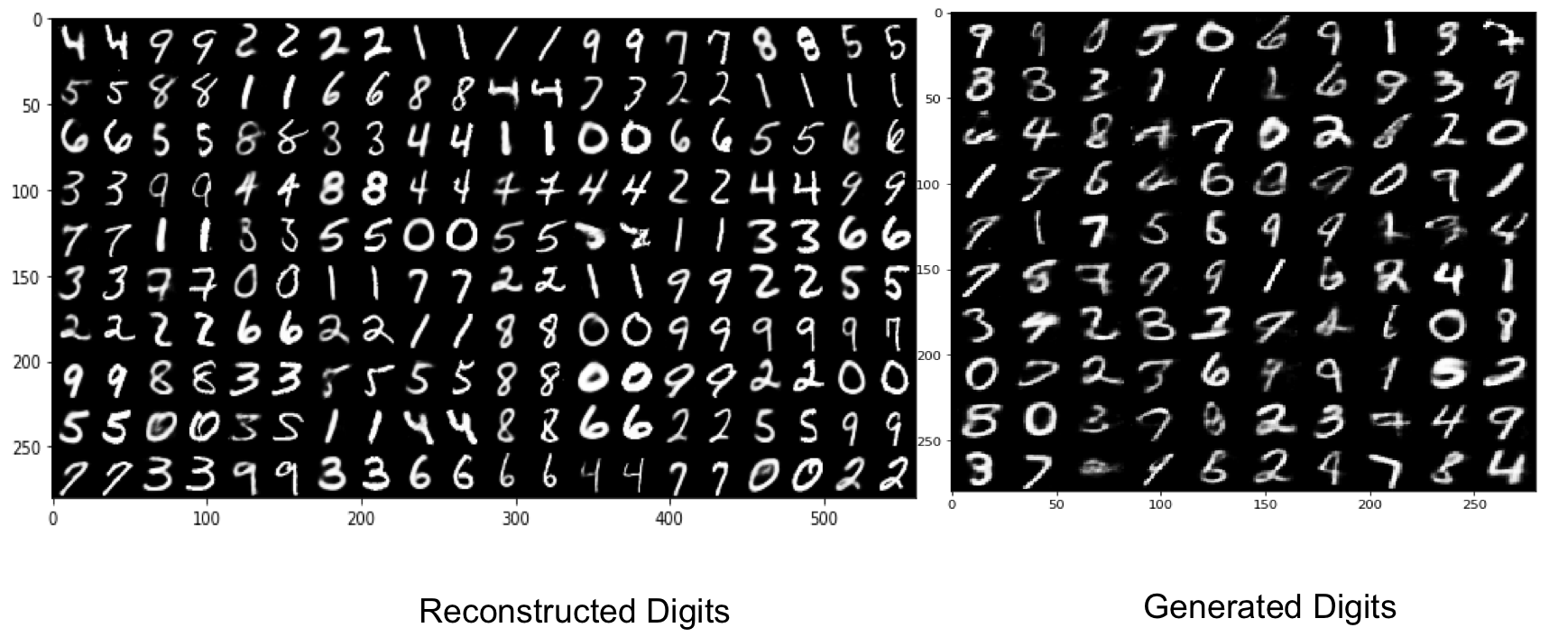

Slide 15


Slide 16
Artificial Intelligence
Cognitive Science
Probability
Programming
Linear Algebra
Philosophy
Neuroscience

Slide 17
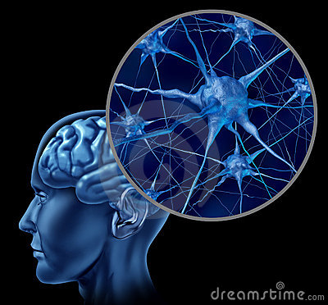
Biological Inspiration
To make the computers more robust and intelligent.
We take inspiration from the intelligent machine ever made
Human Brain

Slide 18
Features of the Brain
Ten billion (10¹⁰) neurons
Neuron switching time >10⁻³secs
Face Recognition ~0.1secs
On average, each neuron has several thousand connections
Hundreds of operations per second
High degree of parallel computation
Distributed representations
Compensated for problems by massive parallelism
Graceful Degradation and Robust

Slide 19
How do we do it?
The brain is a collection of about 10 billion interconnected neurons.
Each neuron is a cell that uses biochemical reactions to receive, process and transmit information.
https://giphy.com/gifs/uofcalifornia-brain-neuroscience-neurons-xT0BKr4MvHdohFTe6s/download

Slide 20
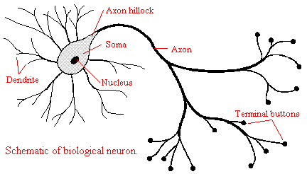
How do we do it?
Notes:
Each terminal button is connected to other neurons across a small gap called a synapse.
Neuron collects signals from dendrites.
Sends out spikes of electrical activity through an axon, which splits into thousands of branches.
At end of each brand, a synapses converts activity into either exciting or inhibiting activity of a dendrite at another neuron.
Neuron fires when exciting activity surpasses inhibitory activity.
Learning changes the effectiveness of the synapses.

Slide 21
Can we make an Artificial Neuron?

Slide 22
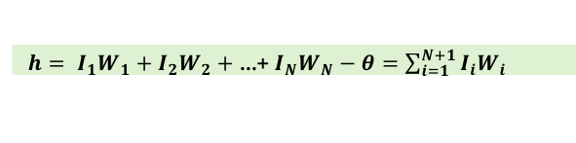
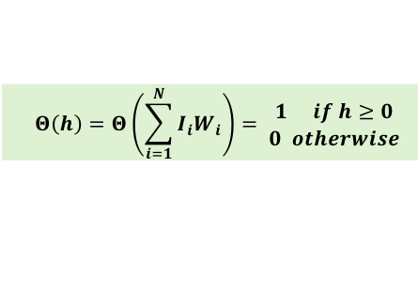
Artificial Neuron
Inputs I
Weights W
Activity
Activation function
$h= I_{1}W_{1}+I_{2}W_{2}+$ ...+ $I_{N}W_{N}−θ=\sum_{i=1}^{N+1}{I_{i}W_{i}}$
$$Θ\left(h\right)=Θ\left(\sum_{i=1}^{N}{I_{i}W_{i}}\right)= \begin{matrix}1 if h≥0 \\ 0 otherwise\end{matrix}$$

Slide 23
What can this single Neuron Do?
Can it think logically?

Slide 24
Logic?
Should I go to college?
If it is raining OR Priyanka Chopra Movie Released?
If there is an important lecture AND I have done the assignment?
If my best friend is NOT coming
AND
OR
NOT

Slide 25
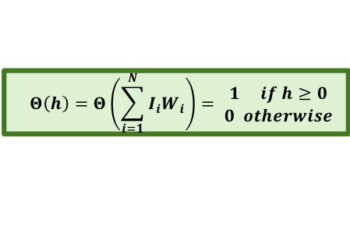
AND Logic
W₁=1, W₂ = 1, θ=2
$$Θ\left(h\right)=Θ\left(\sum_{i=1}^{N}{I_{i}W_{i}}\right)= \begin{matrix}1 if h≥0 \\ 0 otherwise\end{matrix}$$
I₁ | I₂ | h=I₁W₁ + I₂W₂-θ | Θ(h)
1 | 1
1 | 0
0 | 1
0 | 0
I₁
W₁
h
Θ(h)
W₂
I₂

Slide 26
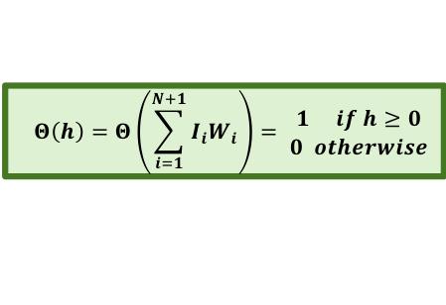
AND Logic
W₁=1, W₂ = 1, θ=2
$$Θ\left(h\right)=Θ\left(\sum_{i=1}^{N+1}{I_{i}W_{i}}\right)= \begin{matrix}1 if h≥0 \\ 0 otherwise\end{matrix}$$
I₁ | I₂ | h=I₁W₁ + I₂W₂-θ | Θ(h)
1 | 1 | 1 + 1 - 2 = 0
1 | 0
0 | 1
0 | 0
I₁
W₁
h
Θ(h)
W₂
I₂

Slide 27
AND Logic
W₁=1, W₂ = 1, θ=2
$$Θ\left(h\right)=Θ\left(\sum_{i=1}^{N+1}{I_{i}W_{i}}\right)= \begin{matrix}1 if h≥0 \\ 0 otherwise\end{matrix}$$
I₁ | I₂ | h=I₁W₁ + I₂W₂-θ | Θ(h)
1 | 1 | 1 + 1 - 2 = 0 | 1
1 | 0
0 | 1
0 | 0
I₁
W₁
h
Θ(h)
W₂
I₂

Slide 28
AND Logic
W₁=1, W₂ = 1, θ=2
$$Θ\left(h\right)=Θ\left(\sum_{i=1}^{N+1}{I_{i}W_{i}}\right)= \begin{matrix}1 if h≥0 \\ 0 otherwise\end{matrix}$$
I₁ | I₂ | h=I₁W₁ + I₂W₂-θ | Θ(h)
1 | 1 | 1 + 1 - 2 = 0 | 1
1 | 0 | 1 + 0 – 2 = -1
0 | 1
0 | 0
I₁
W₁
h
Θ(h)
W₂
I₂

Slide 29
AND Logic
W₁=1, W₂ = 1, θ=2
$$Θ\left(h\right)=Θ\left(\sum_{i=1}^{N+1}{I_{i}W_{i}}\right)= \begin{matrix}1 if h≥0 \\ 0 otherwise\end{matrix}$$
I₁ | I₂ | h=I₁W₁ + I₂W₂-θ | Θ(h)
1 | 1 | 1 + 1 - 2 = 0 | 1
1 | 0 | 1 + 0 – 2 = -1 | 0
0 | 1
0 | 0
I₁
W₁
h
Θ(h)
W₂
I₂

Slide 30
AND Logic
W₁=1, W₂ = 1, θ=2
$$Θ\left(h\right)=Θ\left(\sum_{i=1}^{N+1}{I_{i}W_{i}}\right)= \begin{matrix}1 if h≥0 \\ 0 otherwise\end{matrix}$$
I₁ | I₂ | h=I₁W₁ + I₂W₂-θ | Θ(h)
1 | 1 | 1 + 1 - 2 = 0 | 1
1 | 0 | 1 + 0 – 2 = -1 | 0
0 | 1 | 0 + 1 – 2 = -1
0 | 0
I₁
W₁
h
Θ(h)
W₂
I₂

Slide 31
AND Logic
W₁=1, W₂ = 1, θ=2
$$Θ\left(h\right)=Θ\left(\sum_{i=1}^{N+1}{I_{i}W_{i}}\right)= \begin{matrix}1 if h≥0 \\ 0 otherwise\end{matrix}$$
I₁ | I₂ | h=I₁W₁ + I₂W₂-θ | Θ(h)
1 | 1 | 1 + 1 - 2 = 0 | 1
1 | 0 | 1 + 0 – 2 = -1 | 0
0 | 1 | 0 + 1 – 2 = -1 | 0
0 | 0
I₁
W₁
h
Θ(h)
W₂
I₂

Slide 32
AND Logic
W₁=1, W₂ = 1, θ=2
$$Θ\left(h\right)=Θ\left(\sum_{i=1}^{N+1}{I_{i}W_{i}}\right)= \begin{matrix}1 if h≥0 \\ 0 otherwise\end{matrix}$$
I₁ | I₂ | h=I₁W₁ + I₂W₂-θ | Θ(h)
1 | 1 | 1 + 1 - 2 = 0 | 1
1 | 0 | 1 + 0 – 2 = -1 | 0
0 | 1 | 0 + 1 – 2 = -1 | 0
0 | 0 | 0 + 0 -2 = -2
I₁
W₁
h
Θ(h)
W₂
I₂

Slide 33
AND Logic
W₁=1, W₂ = 1, θ=2
$$Θ\left(h\right)=Θ\left(\sum_{i=1}^{N+1}{I_{i}W_{i}}\right)= \begin{matrix}1 if h≥0 \\ 0 otherwise\end{matrix}$$
I₁ | I₂ | h=I₁W₁ + I₂W₂-θ | Θ(h)
1 | 1 | 1 + 1 - 2 = 0 | 1
1 | 0 | 1 + 0 – 2 = -1 | 0
0 | 1 | 0 + 1 – 2 = -1 | 0
0 | 0 | 0 + 0 -2 = -2 | 0
I₁
W₁
h
Θ(h)
W₂
I₂

Slide 34
OR Logic
W₁=1, W₂ = 1, θ=1
$$Θ\left(h\right)=Θ\left(\sum_{i=1}^{N+1}{I_{i}W_{i}}\right)= \begin{matrix}1 if h≥0 \\ 0 otherwise\end{matrix}$$
I₁ | I₂ | h=I₁W₁ + I₂W₂ -θ | Θ(h)
1 | 1
1 | 0
0 | 1
0 | 0
I₁
W₁
h
Θ(h)
W₂
I₂

Slide 35
OR Logic
W₁=1, W₂ = 1, θ=1
$$Θ\left(h\right)=Θ\left(\sum_{i=1}^{N+1}{I_{i}W_{i}}\right)= \begin{matrix}1 if h≥0 \\ 0 otherwise\end{matrix}$$
I₁ | I₂ | h=I₁W₁ + I₂W₂ -θ | Θ(h)
1 | 1 | 1 + 1 - 1 = 1
1 | 0
0 | 1
0 | 0
I₁
W₁
h
Θ(h)
W₂
I₂

Slide 36
OR Logic
W₁=1, W₂ = 1, θ=1
$$Θ\left(h\right)=Θ\left(\sum_{i=1}^{N+1}{I_{i}W_{i}}\right)= \begin{matrix}1 if h≥0 \\ 0 otherwise\end{matrix}$$
I₁ | I₂ | h=I₁W₁ + I₂W₂ -θ | Θ(h)
1 | 1 | 1 + 1 - 1 = 1 | 1
1 | 0
0 | 1
0 | 0
I₁
W₁
h
Θ(h)
W₂
I₂

Slide 37
OR Logic
W₁=1, W₂ = 1, θ=1
$$Θ\left(h\right)=Θ\left(\sum_{i=1}^{N+1}{I_{i}W_{i}}\right)= \begin{matrix}1 if h≥0 \\ 0 otherwise\end{matrix}$$
I₁ | I₂ | h=I₁W₁ + I₂W₂ -θ | Θ(h)
1 | 1 | 1 + 1 - 1 = 1 | 1
1 | 0 | 1 + 0 – 1 = 0
0 | 1
0 | 0
I₁
W₁
h
Θ(h)
W₂
I₂

Slide 38
OR Logic
W₁=1, W₂ = 1, θ=1
$$Θ\left(h\right)=Θ\left(\sum_{i=1}^{N+1}{I_{i}W_{i}}\right)= \begin{matrix}1 if h≥0 \\ 0 otherwise\end{matrix}$$
I₁ | I₂ | h=I₁W₁ + I₂W₂ -θ | Θ(h)
1 | 1 | 1 + 1 - 1 = 1 | 1
1 | 0 | 1 + 0 – 1 = 0 | 1
0 | 1
0 | 0
I₁
W₁
h
Θ(h)
W₂
I₂

Slide 39
OR Logic
W₁=1, W₂ = 1, θ=1
$$Θ\left(h\right)=Θ\left(\sum_{i=1}^{N+1}{I_{i}W_{i}}\right)= \begin{matrix}1 if h≥0 \\ 0 otherwise\end{matrix}$$
I₁ | I₂ | h=I₁W₁ + I₂W₂ -θ | Θ(h)
1 | 1 | 1 + 1 - 1 = 1 | 1
1 | 0 | 1 + 0 – 1 = 0 | 1
0 | 1 | 0 + 1 – 1 = 0
0 | 0
I₁
W₁
h
Θ(h)
W₂
I₂

Slide 40
OR Logic
W₁=1, W₂ = 1, θ=1
$$Θ\left(h\right)=Θ\left(\sum_{i=1}^{N+1}{I_{i}W_{i}}\right)= \begin{matrix}1 if h≥0 \\ 0 otherwise\end{matrix}$$
I₁ | I₂ | h=I₁W₁ + I₂W₂ -θ | Θ(h)
1 | 1 | 1 + 1 - 1 = 1 | 1
1 | 0 | 1 + 0 – 1 = 0 | 1
0 | 1 | 0 + 1 – 1 = 0 | 1
0 | 0
I₁
W₁
h
Θ(h)
W₂
I₂

Slide 41
OR Logic
W₁=1, W₂ = 1, θ=1
$$Θ\left(h\right)=Θ\left(\sum_{i=1}^{N+1}{I_{i}W_{i}}\right)= \begin{matrix}1 if h≥0 \\ 0 otherwise\end{matrix}$$
I₁ | I₂ | h=I₁W₁ + I₂W₂ -θ | Θ(h)
1 | 1 | 1 + 1 - 1 = 1 | 1
1 | 0 | 1 + 0 – 1 = 0 | 1
0 | 1 | 0 + 1 – 1 = 0 | 1
0 | 0 | 0 + 0 -1 = -1
I₁
W₁
h
Θ(h)
W₂
I₂

Slide 42
OR Logic
W₁=1, W₂ = 1, θ=1
$$Θ\left(h\right)=Θ\left(\sum_{i=1}^{N+1}{I_{i}W_{i}}\right)= \begin{matrix}1 if h≥0 \\ 0 otherwise\end{matrix}$$
I₁ | I₂ | h=I₁W₁ + I₂W₂ -θ | Θ(h)
1 | 1 | 1 + 1 - 1 = 1 | 1
1 | 0 | 1 + 0 – 1 = 0 | 1
0 | 1 | 0 + 1 – 1 = 0 | 1
0 | 0 | 0 + 0 -1 = -1 | 0
I₁
W₁
h
Θ(h)
W₂
I₂

Slide 43
OR Logic
W₁=1, W₂ = 1, θ=1
$$Θ\left(h\right)=Θ\left(\sum_{i=1}^{N+1}{I_{i}W_{i}}\right)= \begin{matrix}1 if h≥0 \\ 0 otherwise\end{matrix}$$
I₁ | I₂ | h=I₁W₁ + I₂W₂ -θ | Θ(h)
1 | 1 | 1 + 1 - 1 = 1 | 1
1 | 0 | 1 + 0 – 1 = 0 | 1
0 | 1 | 0 + 1 – 1 = 0 | 1
0 | 0 | 0 + 0 -1 = -1 | 0
I₁
W₁
h
Θ(h)
W₂
I₂

Slide 44
NOT Logic
W₁=-1, θ=0
$$Θ\left(h\right)=Θ\left(\sum_{i=1}^{N+1}{I_{i}W_{i}}\right)= \begin{matrix}1 if h≥0 \\ 0 otherwise\end{matrix}$$
I₁ | h=I₁W₁ -θ | Θ(h)
1 | -1 - 0 = -1
0
W₁
h
I₁
Θ(h)

Slide 45
NOT Logic
W₁=-1, θ=0
$$Θ\left(h\right)=Θ\left(\sum_{i=1}^{N+1}{I_{i}W_{i}}\right)= \begin{matrix}1 if h≥0 \\ 0 otherwise\end{matrix}$$
I₁ | h=I₁W₁ -θ | Θ(h)
1 | -1 - 0 = -1 | 0
0
W₁
h
I₁
Θ(h)

Slide 46
NOT Logic
W₁=-1, θ=0
$$Θ\left(h\right)=Θ\left(\sum_{i=1}^{N+1}{I_{i}W_{i}}\right)= \begin{matrix}1 if h≥0 \\ 0 otherwise\end{matrix}$$
I₁ | h=I₁W₁ -θ | Θ(h)
1 | -1 - 0 = -1 | 0
0 | 0 - 0 = 0
W₁
h
I₁
Θ(h)

Slide 47
NOT Logic
W₁=-1, θ=0
$$Θ\left(h\right)=Θ\left(\sum_{i=1}^{N+1}{I_{i}W_{i}}\right)= \begin{matrix}1 if h≥0 \\ 0 otherwise\end{matrix}$$
I₁ | h=I₁W₁ -θ | Θ(h)
1 | -1 - 0 = -1 | 0
0 | 0 - 0 = 0 | 1
W₁
h
I₁
Θ(h)

Slide 48
NOT AND(NAND)Logic
W₁= , W₂ = ,
θ=
$$Θ\left(h\right)=Θ\left(\sum_{i=1}^{N+1}{I_{i}W_{i}}\right)= \begin{matrix}1 if h≥0 \\ 0 otherwise\end{matrix}$$
I₁ | I₂ | h=I₁W₁ + I₂W₂-θ | Θ(h)
1 | 1 |  | 0
1 | 0 |  | 1
0 | 1 |  | 1
0 | 0 |  | 1
I₁
W₁
h
Θ(h)
W₂
I₂

Slide 49
NOT AND(NAND)Logic
W₁= -1 , W₂ = -1 ,
θ= -1.5
$$Θ\left(h\right)=Θ\left(\sum_{i=1}^{N+1}{I_{i}W_{i}}\right)= \begin{matrix}1 if h≥0 \\ 0 otherwise\end{matrix}$$
I₁ | I₂ | h=I₁W₁ + I₂W₂-θ | Θ(h)
1 | 1 | -1 -1 +1.5 = -0.5 | 0
1 | 0 | -1+0+1.5= 0.5 | 1
0 | 1 | 0-1+1.5=0.5 | 1
0 | 0 | 0+0+1.5=1.5 | 1
I₁
W₁
h
Θ(h)
W₂
I₂

Slide 50
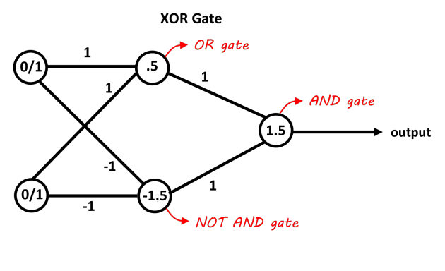
XOR Logic
I₁ | I₂ | h=I₁W₁ + I₂W₂ -θ | Θ(h)
1 | 1 | ? | 0
1 | 0 | ? | 1
0 | 1 | ? | 1
0 | 0 | ? | 0

Slide 51
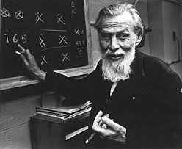
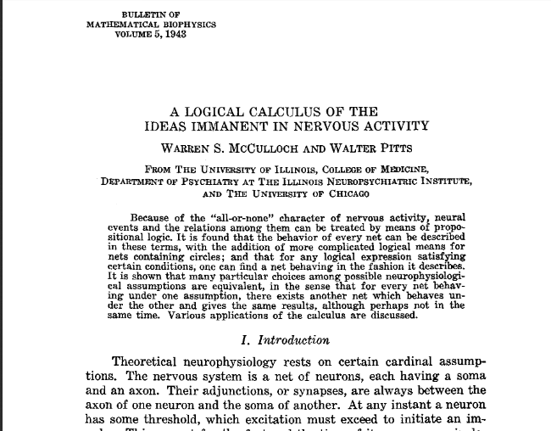
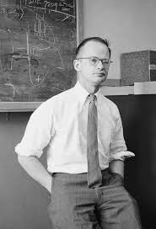
Warren McCulloch
McCulloch Pitts Model
Walter Pitts
Notes:
1943
At this time Von Neuman was still busy designing computer
The first computer was completed in 1946 (started 1943) By Eckert and Mauchly at University of Pennsylvania. Contained 18,000 vacuum tubes and weighed 50 tons. And occupied 1,800 sqft area

Slide 52
Can it Learn?
How does human learn?
Parents and teachers teach us
We read books and introspect what they mean
Motivated by a goal: Good job, praise from peers, desire to excel=> Force us to learn.

Slide 53
Can it Learn?
How does human learn?
Parents and teachers teach us:
Supervised Learning
We read books and introspect what they mean
Unsupervised Learning
Motivated by a goal: Good job, praise from peers, desire to excel=> Force us to learn
Reinforcement Learning

Slide 54
Supervised Learning:
Classification/Regression
Multilayered Perceptrons (MLP)
Convolutional Neural Networks (CNN)
Unsupervised Learning:
Dimensionality Reduction/ Generating Data
Self Organized Maps (SOM)
Restricted Boltzmann Machines (RBM)
Reinforcement Learning: Robotics/ Inventory Management
Q- learning
Monte Carlo Methods
Recurrent Neural Networks (RNN)
Autoencoders
Generative Adversial Networks (GANs)
Deep Belief Networks
Deep Belief Networks
Temporal Difference Methods
DQN
Policy Gradients

Slide 55
The most understood learning
Supervised Learning

Slide 56
The most understood learning
Supervised Learning
Input, Output pair is given as the training data (x, y).
With large data we divide it into Training, Testing and Cross Validation
Training Data
Testing Data
Model
Model

Slide 57
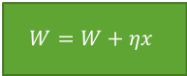
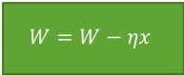
Assign random values to the weight vector
Present input, output pair (x, y)
Calculate h
Calculate output Θ(h)
Θ(h) == y
Choose Next input, output pair
Yes
No
$$W=W+ηx$$
No
Θ(h) > y
$$W=W−ηx$$
Yes
Notes:
What is machine learning?

Slide 58

Learn AND Logic?
$$θ=W_{3}I_{3}$$
W₁=0, W₂ = 0, W₃=0 ; I₃ = -1
$$Θ\left(h\right)=Θ\left(\sum_{i=1}^{N}{I_{i}W_{i}}\right)= \begin{matrix}1 if h≥0 \\ 0 otherwise\end{matrix}$$
I₁ | I₂ | h=I₁W₁ + I₂W₂+I₃W₃ | Θ(h) | Desired | Weights
1 | 1 | 0 + 0 - 0 = 0 | 1 | 1 | Unchanged
1 | 0 | 0 + 0 - 0 = 0 | 1 | 0 | Decrease
0 | 1 | 0 + 0 - 0 = 0 | 1 | 0 | Decrease
0 | 0 | 0 + 0 - 0 = 0 | 1 | 0 | Decrease
I₁
W₁
h
Θ(h)
W₂
I₂

Slide 59
Learn AND Logic?
W₁=0, W₂ = 0, W₃=0 ;
I₃ = -1
$$Θ\left(h\right)=Θ\left(\sum_{i=1}^{N}{I_{i}W_{i}}\right)= \begin{matrix}1 if h≥0 \\ 0 otherwise\end{matrix}$$
I₁ | I₂ | h=I₁W₁ + I₂W₂+I₃W₃ | Θ(h) | Desired | Weights | New Weights
1 | 1 | 0 + 0 - 0 = 0 | 1 | 1 | Unchanged | W₁=0, W₂ = 0, W₃=0

Slide 60
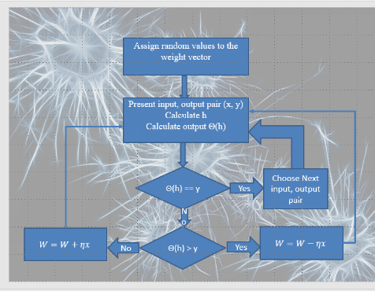
Learn AND Logic?
W₁=0, W₂ = 0, W₃=0 ;
I₃ = -1
$$Θ\left(h\right)=Θ\left(\sum_{i=1}^{N}{I_{i}W_{i}}\right)= \begin{matrix}1 if h≥0 \\ 0 otherwise\end{matrix}$$
I₁ | I₂ | h=I₁W₁ + I₂W₂+I₃W₃ | Θ(h) | Desired | Weights | New Weights
1 | 1 | 0 + 0 - 0 = 0 | 1 | 1 | Unchanged | W₁=0, W₂ = 0, W₃=0
1 | 0 | 0 + 0 - 0 = 0 | 1 | 0 | Decrease | W1 = W1-I1 = -1 W2= W2-I2 = 0 W3 = W3-I3= +1

Slide 61
Learn AND Logic?
W₁=-1, W₂ = 0, W₃=1 ; I₃ = -1
$$Θ\left(h\right)=Θ\left(\sum_{i=1}^{N}{I_{i}W_{i}}\right)= \begin{matrix}1 if h≥0 \\ 0 otherwise\end{matrix}$$
I₁ | I₂ | h=I₁W₁ + I₂W₂+I₃W₃ | Θ(h) | Desired | Weights | New Weights
1 | 1 | 0 + 0 - 0 = 0 | 1 | 1 | Unchanged | W₁=0, W₂ = 0, W₃=0
1 | 0 | 0 + 0 - 0 = 0 | 1 | 0 | Decrease | W1 = W1-I1 = -1 W2= W2-I2 = 0 W3 = W3-I3= +1
1 | 0

Slide 62
Learn AND Logic?
W₁=-1, W₂ = 0, W₃=1 ;
I₃ = -1
$$Θ\left(h\right)=Θ\left(\sum_{i=1}^{N}{I_{i}W_{i}}\right)= \begin{matrix}1 if h≥0 \\ 0 otherwise\end{matrix}$$
I₁ | I₂ | h=I₁W₁ + I₂W₂+I₃W₃ | Θ(h) | Desired | Weights | New Weights
1 | 1 | 0 + 0 - 0 = 0 | 1 | 1 | Unchanged | W₁=0, W₂ = 0, W₃=0
1 | 0 | 0 + 0 - 0 = 0 | 1 | 0 | Decrease | W1 = W1-I1 = -1 W2= W2-I2 = 0 W3 = W3-I3= +1
1 | 0 | -1 + 0 - 1 = 0 | 1 | 1 | Unchanged | W₁=-1, W₂ = 0, W₃=1

Slide 63
Learn AND Logic?
W₁=-1, W₂ = 0, W₃=1 ;
I₃ = -1
$$Θ\left(h\right)=Θ\left(\sum_{i=1}^{N}{I_{i}W_{i}}\right)= \begin{matrix}1 if h≥0 \\ 0 otherwise\end{matrix}$$
I₁ | I₂ | h=I₁W₁ + I₂W₂+I₃W₃ | Θ(h) | Desired | Weights | New Weights
1 | 1 | 0 + 0 - 0 = 0 | 1 | 1 | Unchanged | W₁=0, W₂ = 0, W₃=0
1 | 0 | 0 + 0 - 0 = 0 | 1 | 0 | Decrease | W1 = W1-I1 = -1 W2= W2-I2 = 0 W3 = W3-I3= +1
1 | 0 | -1 + 0 - 1 = -2 | 0 | 0 | Unchanged | W₁=-1, W₂ = 0, W₃=1
0 | 1 | 0 + 0 – 1 = -1 | 0 | 0 | Unchanged | W₁=-1, W₂ = 0, W₃=1

Slide 64
Learn AND Logic?
W₁=-1, W₂ = 0, W₃=1 ;
I₃ = -1
$$Θ\left(h\right)=Θ\left(\sum_{i=1}^{N}{I_{i}W_{i}}\right)= \begin{matrix}1 if h≥0 \\ 0 otherwise\end{matrix}$$
I₁ | I₂ | h=I₁W₁ + I₂W₂+I₃W₃ | Θ(h) | Desired | Weights | New Weights
1 | 1 | 0 + 0 - 0 = 0 | 1 | 1 | Unchanged | W₁=0, W₂ = 0, W₃=0
1 | 0 | 0 + 0 - 0 = 0 | 1 | 0 | Decrease | W1 = W1-I1 = -1 W2= W2-I2 = 0 W3 = W3-I3= +1
1 | 0 | -1 + 0 - 1 = -2 | 0 | 0 | Unchanged | W₁=-1, W₂ = 0, W₃=1
0 | 1 | 0 + 0 – 1 = -1 | 0 | 0 | Unchanged | W₁=-1, W₂ = 0, W₃=1
0 | 0 | 0 + 0 – 1 = -1 | 0 | 0 | Unchanged | W₁=-1, W₂ = 0, W₃=1

Slide 65
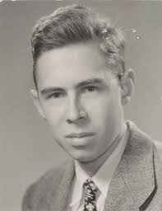
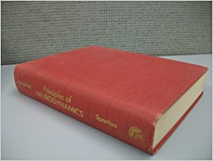
Frank Rosenblatt
Perceptron
Principles of Neurodynamics: Perceptrons and the Theory of Brain Mechanisms
“[The perceptron] is the embryo of an electronic computer that [The Navy] expects will be able to walk, talk, see, write, reproduce itself and be conscious of its existence.”
-Frank Rosenblatt

Slide 66

But!!

Slide 67
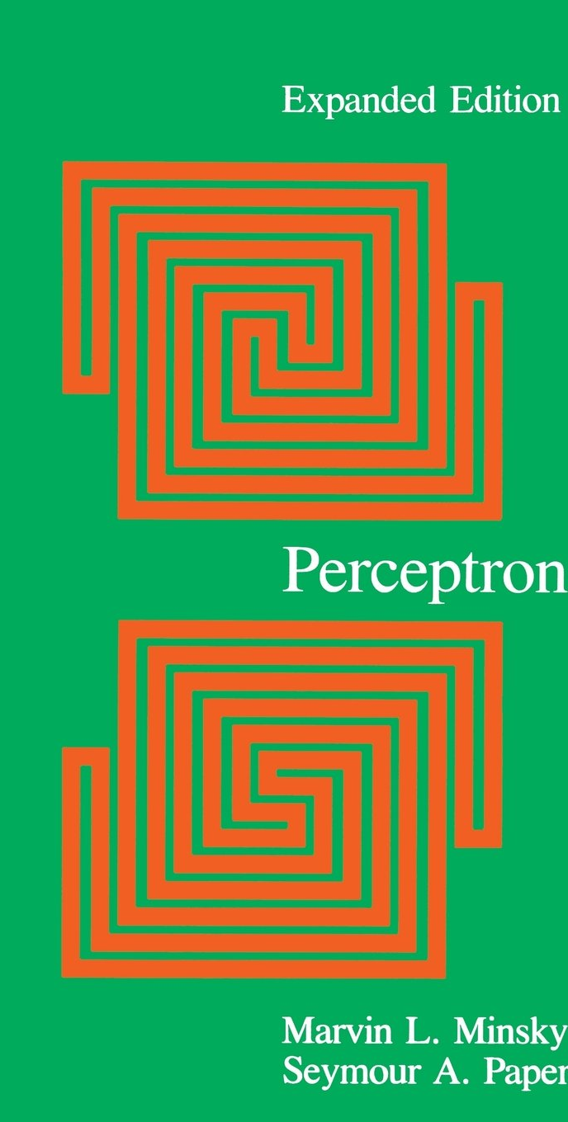
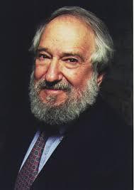
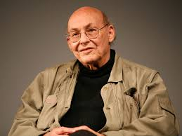
Marvin Minsky Seymour Papert
Detailed Study of Perceptrons and their capabilities.
Proved Perceptron cannot solve non-linearly separable problems. Eg. XOR.
In addition, training time grows exponentially with the size of the input.
Notes:
1969

Slide 68
Linearly vs Non-linearly Separable
Linearly separable
Non-linearly separable
Notes:
What is machine learning?

Slide 69
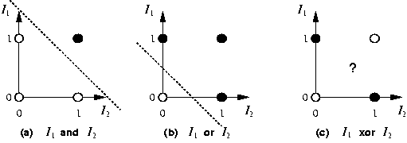
AND/OR/ XOR
The First AI Winter 1974-1980

Slide 70
AI Failure’s
1969: Non linear problems.
1966:Machine Translation
1971-1975: Speech Understanding
James Lighthill paper “Artificial Intelligence: A General Survey”
AI researchers had failed to address the issue of combinatorial explosion when solving problems within real world domains.
That is, the report states that AI techniques may work within the scope of small problem domains, but the techniques would not scale up well to solve more realistic problems.
The report represents a pessimistic view of AI that began after early excitement in the field.

Slide 71
Neural Networks
What if we connect many such artificial neurons?

Slide 72
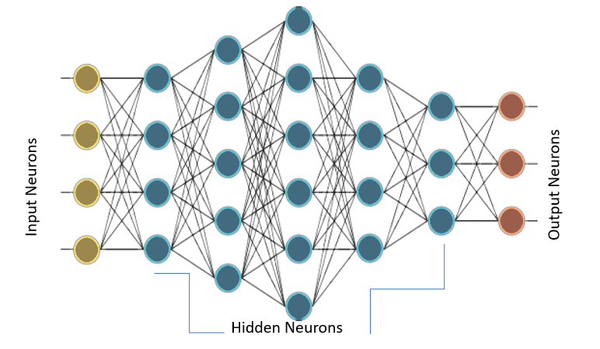
Multilayer Perceptron (MLP)

Slide 73
But then how will we train them?

Slide 74
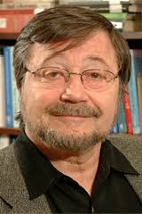

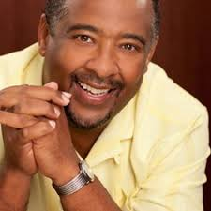
Back Propagation Algorithm
David Rumelhart
Geoffrey Hinton
Ronald Williams
BPA was derived in 1960 by Henry J Kelley for Control theory
In 1986 Rumelhart, Hinton and Williams showed experimentally that BPA can generate useful internal representation of incoming data in hidden layers.

Slide 75
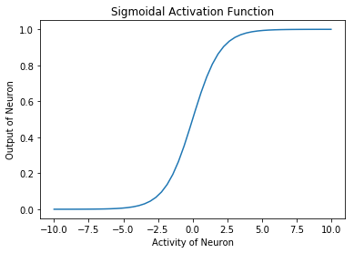
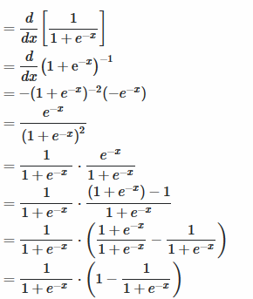
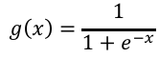
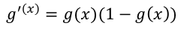
Changes for BPA
The activation function should be differentiable
Sigmoid function
$$g\left(x\right)=\frac{1}{1+e^{−x}}$$
$$g^{′\left(x\right)}=g(x)(1−g\left(x\right))$$

Slide 76
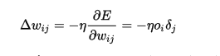
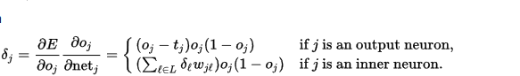
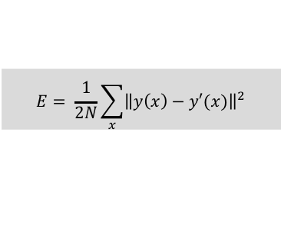
Gradient Descent Algorithm
$$E= \frac{1}{2N}\sum_{x}{{\left\|y\left(x\right)−y′(x)\right\|}^{2}}$$

Slide 77
Questions

